Slide 1

Recommendation System for Toronto Restaurants
Team Standard Deviations: Arpan Banerjee, Bitan Biswas, Harsh Vardhan Goyal, Sukriti Paul

Slide 2
Contents:
1.Baseline model using linear regression
2.Collaborative Filtering with Stochastic Gradient descent
3.Predictions & PCA analysis
1.Visualizations
2.Rigorous Eda
3.Feature engineering
1.Assessing the Yelp dataset
2.Sub setting The data
3.Cleaning the Data
4.initial Eda

Slide 3
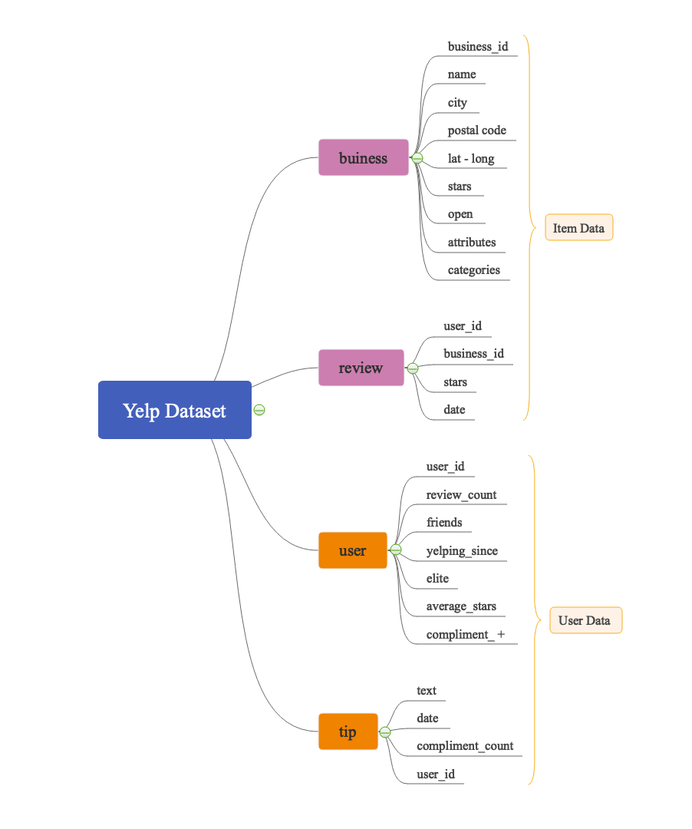
Assessing the Dataset:
The Yelp dataset has essentially 5 .json files, out which we chose to use 4. Namely, business.json, reviews.json, users.json, tips.json.
business.json:the details about the different businesses with their average ratings.
user.json: the data about all the users of Yelp
reviews.json:the data of the users who have been to certain businesses and rated and reviewed them.
tips.json : the data about the users who have given tips while they visited certain businesses.

Slide 4
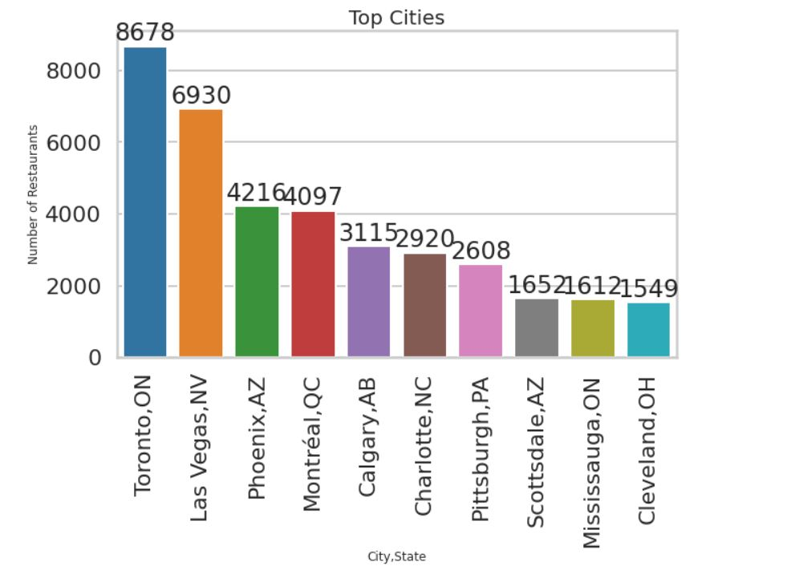
Subsetting the Data:
The business dataset seems to have a lot of businesses out of which, the most common is the restaurants.
We further subset the restaurants and find that the Toronto City has the highest number of restaurants.
Hence, we consider only those restaurants that are located in Toronto, Ontario

Slide 5
User Dataset
Pair Wise correlation Heat-map
Correlation vs Average Stars Bar Graph

Slide 6
User Data Distribution
Feature Distribution
Average Stars vs Feature

Slide 7
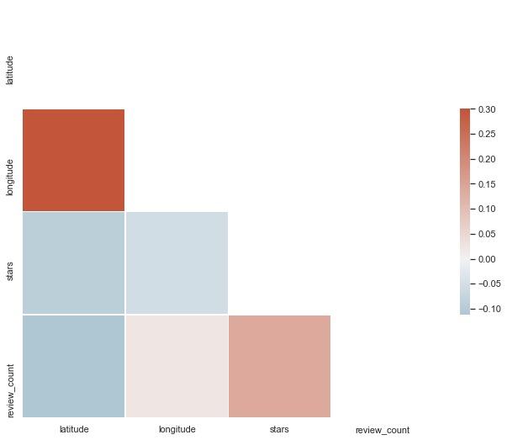
Business Dataset
Heat-map Business dataset without Flattening

Slide 8
A Poor Linear Regression Model
Distribution of Average stars in Test Set
Distribution of Average Stars Predicted by our Initial Linear Regression
average_stars
Baseline model using the Business, Users Dataset

Slide 9
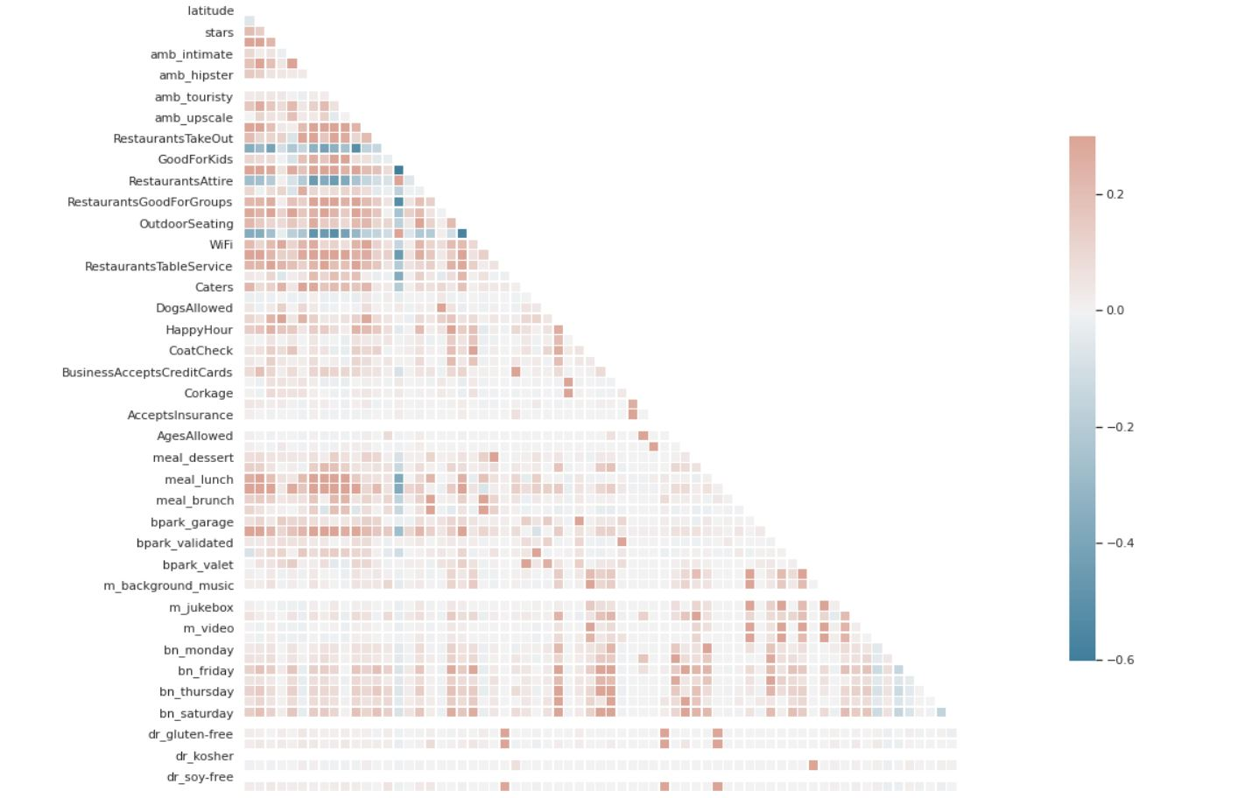
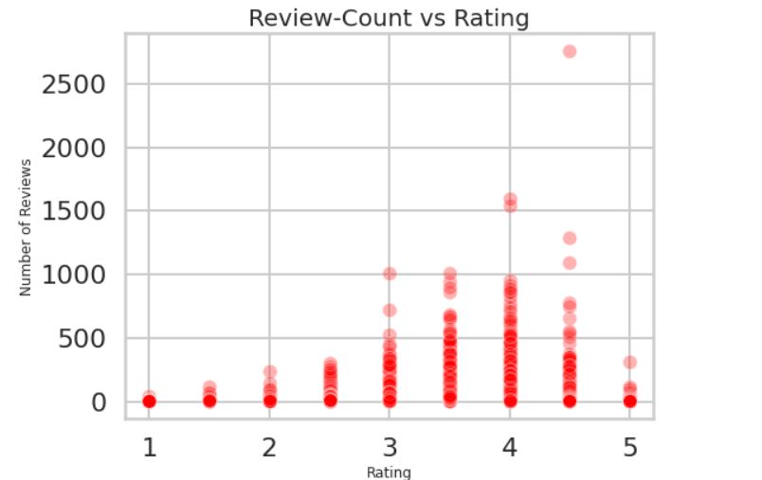
Cleaning/ Flattening the Data:
The review dataset is also cleaned of Time, Location and review factors. Count Vectorizer although Used , Doesn’t Seem to be very Useful and hence the Reviews are omitted. Users and Tips Datasets are also subset and Cleaned to Limit them only to Toronto Restaurants
Cleaning the Columns of dictionary form (Attributes, categories, Ambience),which are flattened and converted to Category type to obtain more information about the Restaurants. Null Cases are converted to “false” based on the column value observations.
The Business dataset of Toronto Restaurants is Cleaned of excess, unnecessary columns
The data is cleaned, nulls are handled, and exploratory data analysis is carried out on the different columns to find the correlations between the different columns.
The dataset essentially has only those restaurants information which are open i.e., ‘is_open’ attribute is 1.

Slide 10
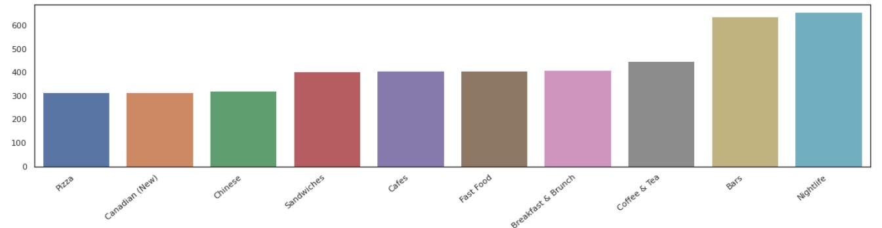
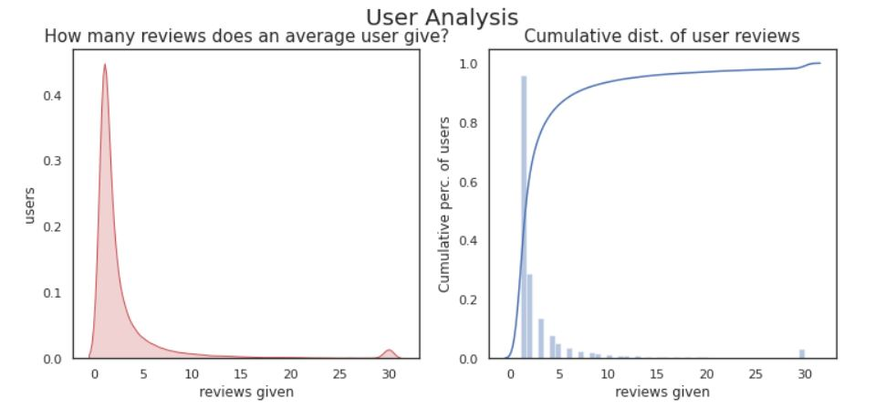
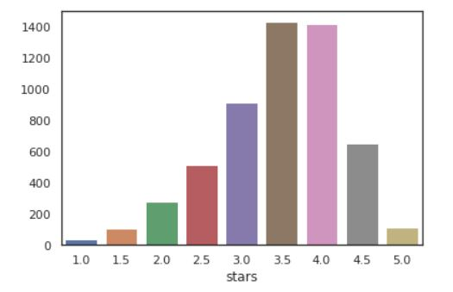
Extended EDA and Feature Engineering:
1.We see that Bars and Nightlife have a huge number of openings in Toronto
2.The reviews given per user is between 0-3
3.The ratings are mostly in the 3.5-4.5 band.

Slide 11
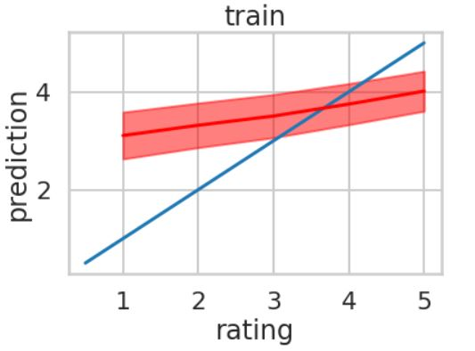
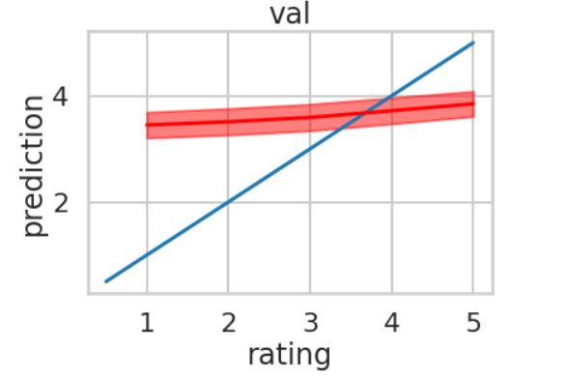
Baseline Model: Our Baseline Model is a Linear regression model where we consider only the user bias, the restaurants bias and the average rating given by the users to the Toronto restaurants. The training Mean Squared Error comes around 1.14 and the test MSE comes around 1.5. The model is a simple addition function of the biases and the average rating without any residual factors.

Slide 12
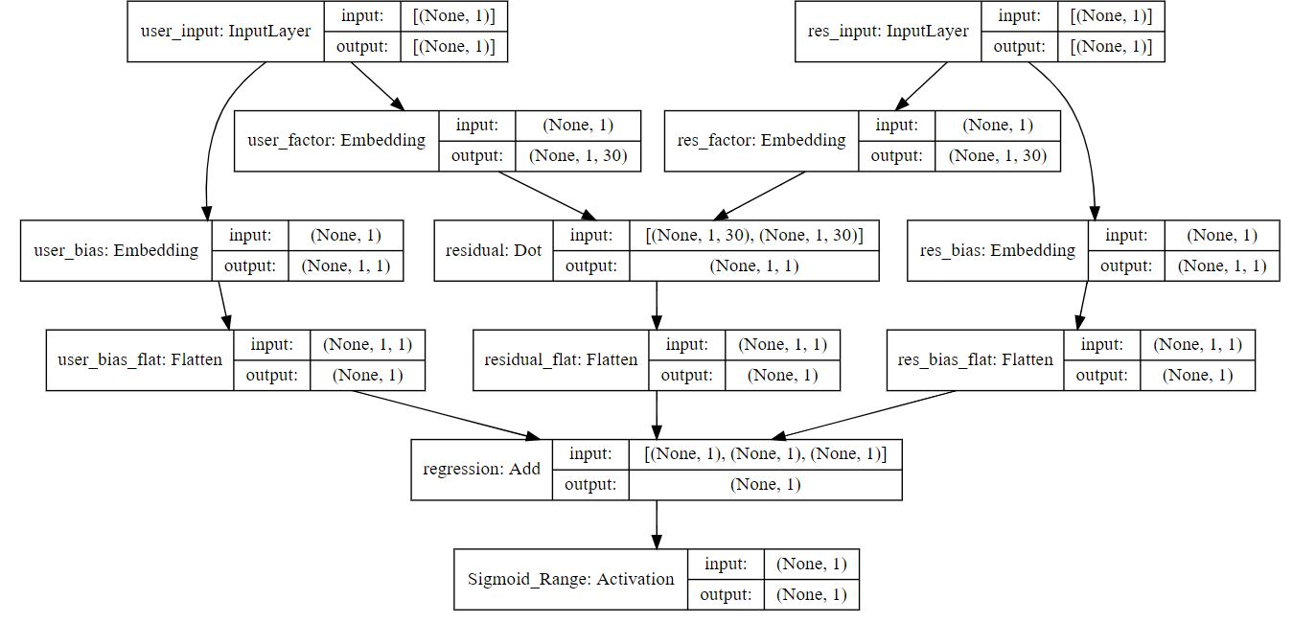
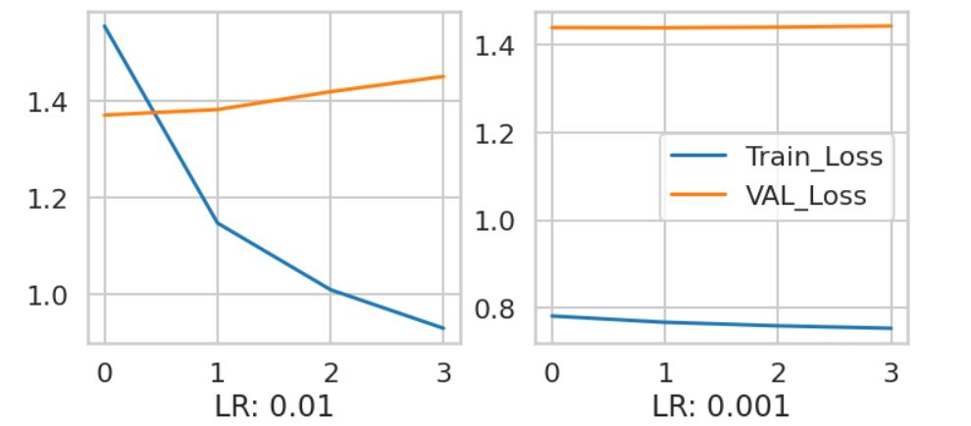
Collaborative Filtering Using Stochastic Gradient:
Here, we use a 6-Layered
Neural Network Model
with Stochastic Gradient
Learning rate of 0.01(as the
optimum one)

Slide 13
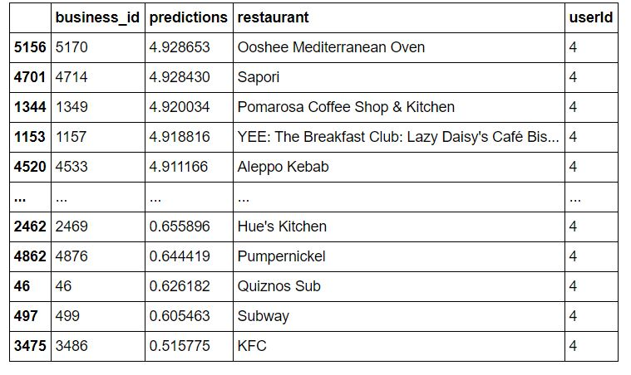
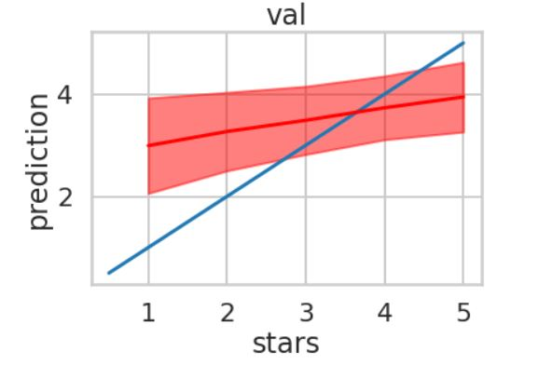
Predictions:
1st Graph: The predictions for the user id ‘4’.
The training loss is 0.7 and test loss was approximately 1.4.

Slide 14
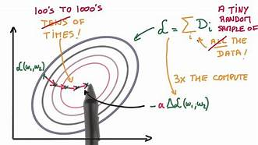
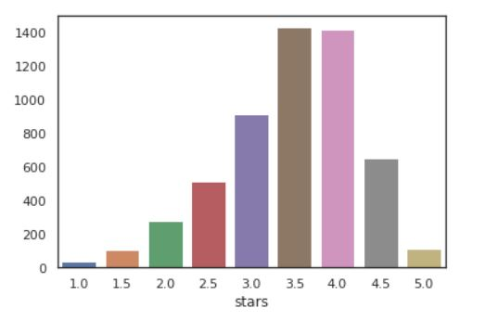
Conclusion and Future Prospect:
The Yelp dataset has most of the ratings in the range of 3.5-4.5 and as a result, our model predicts well or close to the actual ratings only for that range and doesn’t do a great job for the lower ratings due to insufficient data.
Future Prospects lie in adding a geospatial feature to recommend the user good food places nearby!

